Slide 1
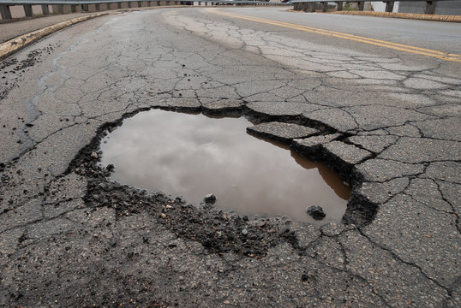
Instance Segmentation of Potholes
Using YOLOv8 & Pixel-Based Area Calculation
Automated detection, segmentation, and real-world area estimation of road potholes using state-of-the-art deep learning.

Slide 2
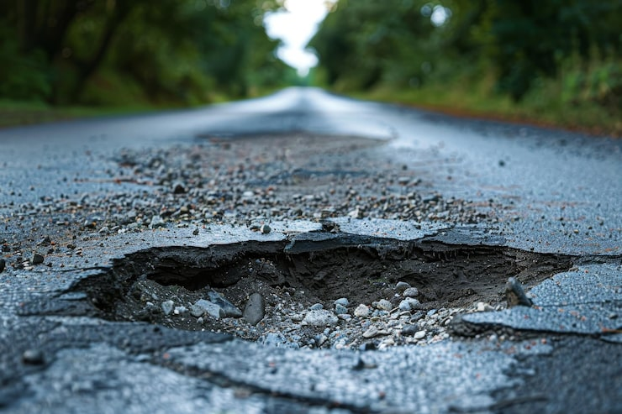



The Pothole Problem & Our Solution
Why Potholes Matter
Potholes cause vehicle damage, accidents, and road fatalities worldwide
Manual road inspection is slow, costly, and inconsistent
Urban road networks require
scalable, automated monitoring
Our Solution: Deploy YOLOv8 instance segmentation to automatically detect potholes and compute their real-world area using pixel-to-metric mapping.

Slide 3




Understanding YOLOv8 for Instance Segmentation
Object Detection
Identifies and localises objects with precise bounding boxes in real time
Instance Segmentation
Generates pixel-level masks for each detected object 4 crucial for area calculation
YOLOv8 Advantage
Faster, more accurate, and lightweight compared to predecessors 4 ideal for deployment

Slide 4





Our Methodology
Data Collection
YOLOv8
Training
Inference & Masks
Area Calculation
The pipeline begins with a curated pothole dataset annotated with polygon masks. YOLOv8 is fine-tuned, then deployed to generate instance masks per detection — feeding directly into our area estimation module.

Slide 5
Pixel-Based Area Calculation
Step-by-Step Process
01
Extract Segmentation Mask
Count total foreground pixels in the predicted binary mask
02
Determine Scale Factor
Calibrate using known reference distance or camera parameters (pixels/cm)
03
Convert to Real Area
Area (cm²) = Pixel Count ÷ (Scale Factor)²
Key Formula:
Real Area = N_pixels × (GSD)²
Where GSD = Ground Sampling Distance
(cm/pixel), derived from camera height and focal length.
Accurate calibration is the most critical step — even a small error in GSD propagates through all area estimates.

Slide 6
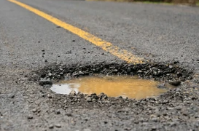
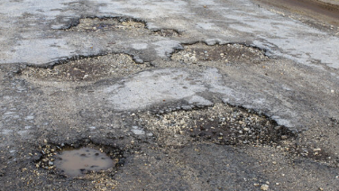
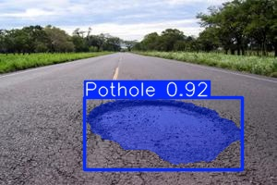
Visualising Results: Pothole Detections
YOLOv8 generates colour-coded instance masks overlaid on the original image, with bounding boxes, confidence scores, and computed area labels for each detected pothole.
Urban Road Pothole
Single large pothole with segmentation mask overlay and area annotation
Multi-Instance Detection
Several potholes detected simultaneously with distinct coloured masks
Confidence & Area Output
Confidence score and pixel-derived area (cm²) displayed per instance

Slide 7
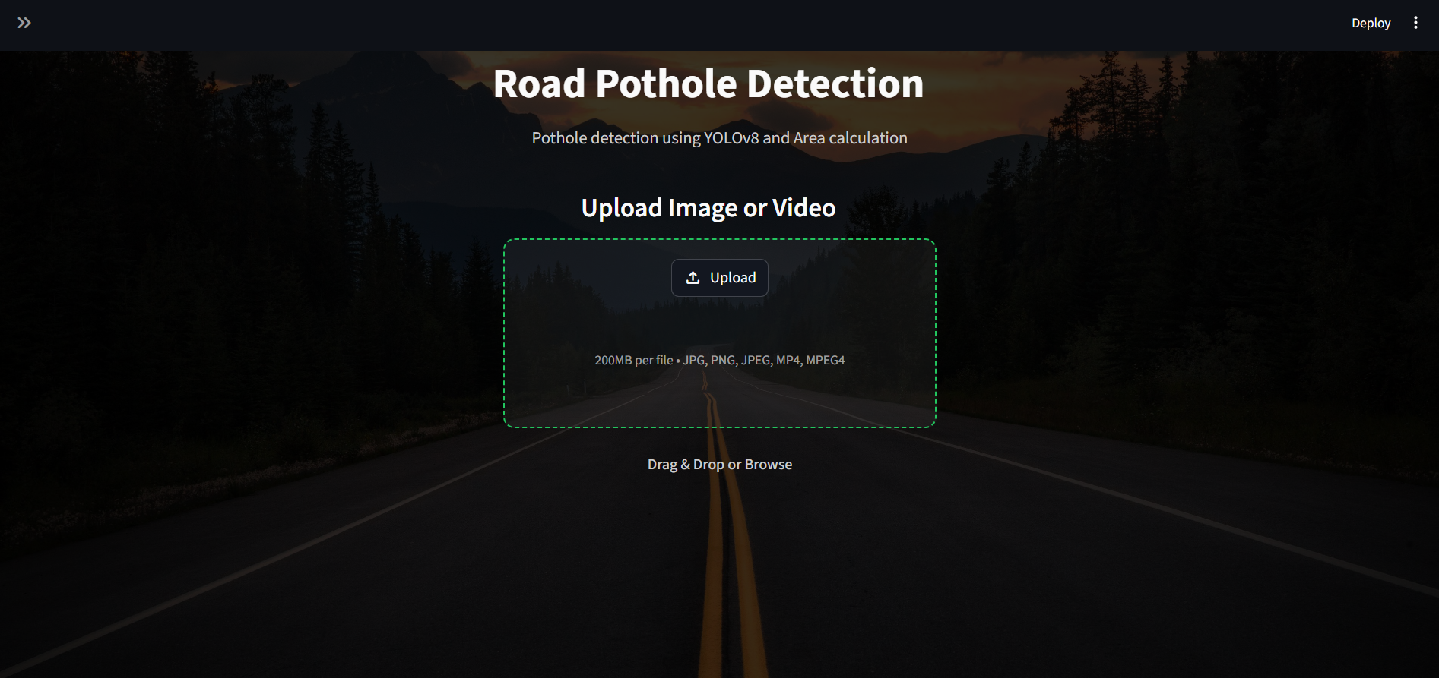

Slide 8
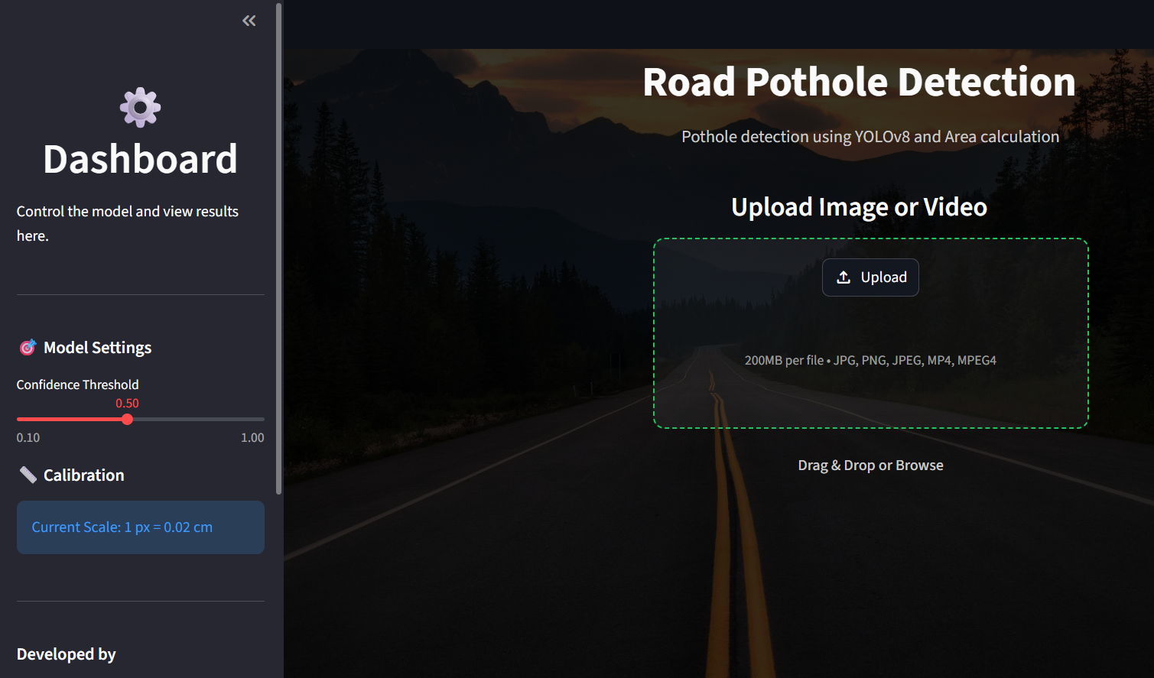

Slide 9
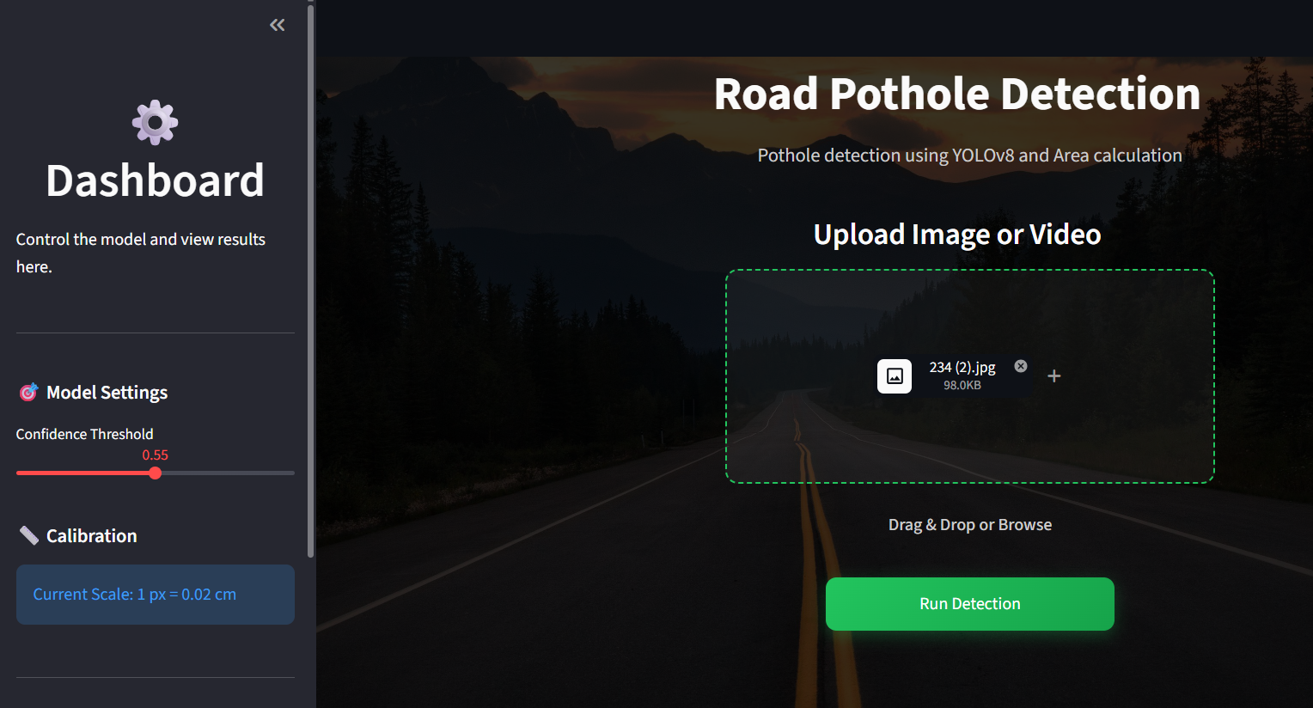

Slide 10
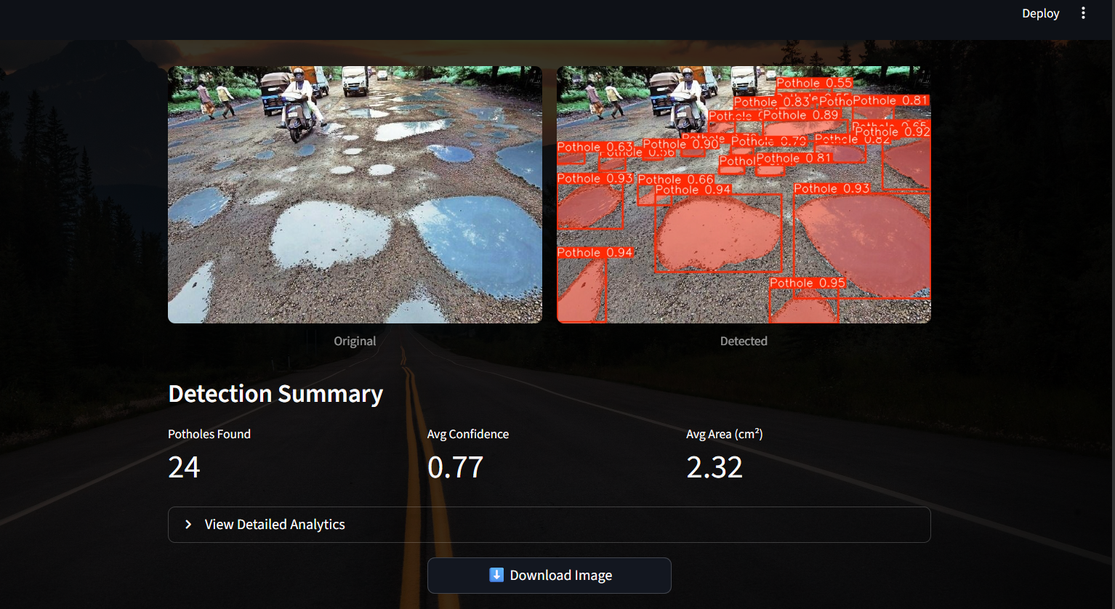

Slide 11
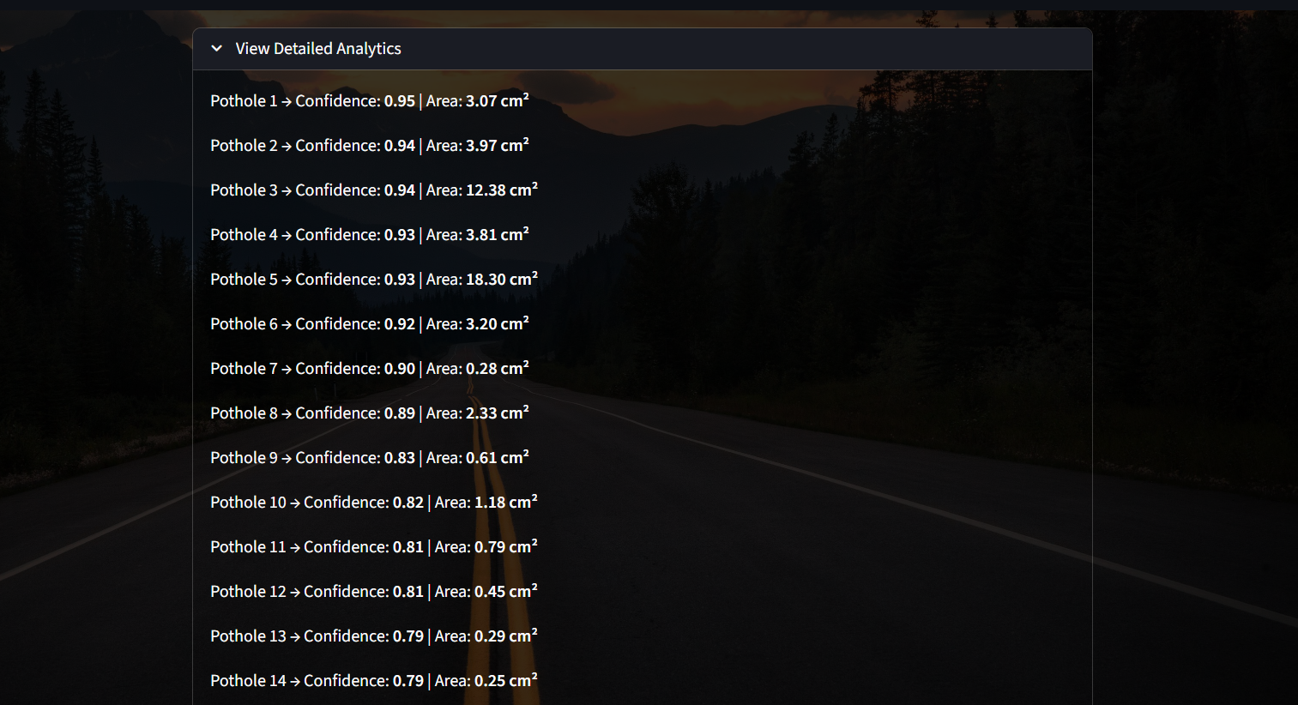

Slide 12
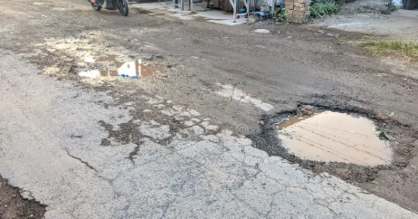
Case Studies & Real-World Scenarios
Key Findings
Model achieves mAP@50 of ~88% on the test set
Accurately segments potholes ranging from 50 cm² to 1.5 m²
Robust to varying lighting, wet surfaces, and shadow conditions
Processes each frame in under 30 ms
on GPU (real-time capable)
Flooded Pothole
Water-filled potholes 4 model handles reflective surfaces with strong mask accuracy
Post-Repair Monitoring
Area tracking before and after repair verifies fix completeness

Slide 13
Advantages & Limitations
✅ Advantages
Fully automated — no manual measurement required Pixel-level precision for accurate area estimation Scalable to dashcam or drone footage
Area Calculation
⚠ Limitations
Area accuracy depends on precise camera calibration Performance might degrades under extreme night conditions Overlapping or clustered potholes may merge masks Requires annotated training data for fine-tuning
GSD calibration errors can cause up to 15–20% deviation in real-world area estimates.

Slide 14




Future Enhancements & Next Steps
Depth Sensor Integration
Use LiDAR or stereo cameras to estimate pothole volume and depth, not just surface area
Drone-Based Surveying
Deploy on UAVs for rapid, large-scale road condition surveys with georeferenced outputs
Severity Scoring
Classify potholes by area + depth into Low / Medium / Critical
repair priority tiers
GIS Mapping Integration
Log detections with GPS coordinates to build a live city-wide road damage heatmap

Slide 15
Q&A and Discussion
Thank You!
We welcome your questions on methodology, results, and potential real-world deployment of this system.
t Dataset & Training
Questions on data annotation, augmentation, or training configuration?
x Area Calculation
Queries on calibration methods, GSD computation, or metric accuracy?
Deployment
Interest in real-world integration with smart city or municipal systems?

